Slide 1

MACHINE LEARNING BASED PROPERTY PRICE PREDICTION
Submitted by: Under the Mentorship of:
NAME: SHAURYA PUNDIR Mr. Vivek Tomar
Univ. Roll No.: 2021975 Assistant Professor
SECTION: AI
COURSE: B.tech cse (AI)

Slide 2


INTRODUCTION
The real estate market is dynamic and ever-changing, with property values influenced by a multitude of factors. Whether you’re a homebuyer, seller, or investor, understanding the intricacies of house prices is crucial. In recent years, machine learning (ML) has emerged as a powerful tool for predicting house prices accurately. In this project, we delve into the fascinating world of house price prediction using ML techniques.

Slide 3


Problem Statement
The primary goal of our project is to build a robust ML model that can predict house prices based on relevant features. Given a set of input variables (such as square footage, number of bedrooms, location, etc.), our model will estimate the sale price of a house. This prediction can aid homebuyers in making informed decisions, assist real estate agents in pricing properties, and guide investors toward profitable opportunities.

Slide 4

METHODOLOGY
1. Data Collection and Initial Exploration:
Import Libraries: Necessary libraries like pandas, numpy, matplotlib, and seaborn are imported.
Load Dataset: The Bengaluru house price dataset (Bengaluru_House_Data.csv) is loaded using pd.read_csv().
Initial Exploration: The dataset is inspected using df.info() to understand the data types and missing values, and df.shape to check the number of rows and columns.
2. Data Cleaning and Preprocessing:
Drop Irrelevant Columns: Columns like 'society', 'area_type', 'availability', and 'balcony' are dropped using df.drop() as they are deemed less relevant for price prediction.
Handle Missing Values: Missing values in 'location' are filled with the most frequent value ('Sarjapur Road') using df['location'].fillna(). Missing values in 'size' are filled with the mode ('2 BHK') using df.fillna(). Missing values in 'bath' are filled with the median using df.fillna(df['bath'].median()).
Clean Location Data: Spaces in location names are removed using df['location'].apply(lambda x: x.strip()).Locations with less than 10 occurrences are grouped into an 'other' category to reduce dimensionality.

Slide 5

METHODOLOGY(contd.)
3. Feature Engineering:
Extract BHK: The number of bedrooms (BHK) is extracted from the 'size' column using string splitting and converted to an integer using astype(int).
Drop 'size' Column: The original 'size' column is dropped as it is now represented by the 'BHK' feature.
Handle 'total_sqft' Ranges: A function convertt() is defined to calculate the average square footage for entries with ranges (e.g., '1000-1200'). This function is applied to the 'total_sqft' column.
Calculate Price Per Square Foot: A new feature 'Price_Per_sqft' is created by dividing the price by the total square footage.
4. Outlier Removal:
Remove Outliers Based on Square Footage:For each location, the mean and standard deviation of 'Price_Per_sqft' are calculated.Data points outside one standard deviation from the mean are considered outliers and removed.
Remove BHK Outliers: A function bhk_outlier_remover() is defined to identify and remove BHK outliers based on price per square foot within each location. This function compares the price per square foot of a BHK with the average of the previous BHK type in the same location.

Slide 6

METHODOLOGY(contd.)
5.Model Building and Evaluation:
Split Data: The dataset is split into training and testing sets using train_test_split() with a test size of 0.2.
One-Hot Encoding: One-hot encoding is applied to the 'location' feature using OneHotEncoder() to convert categorical data into numerical format.
Standard Scaling: Numerical features are scaled using StandardScaler() to ensure they have a similar range.
Model Training:
A Linear Regression model is instantiated and trained using LinearRegression().
A Lasso Regression model is instantiated and trained using Lasso().
An Artificial Neural Network Regressor model is instantiated and train using MLPRegressor().

Slide 7

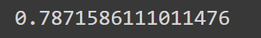
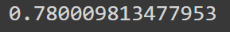
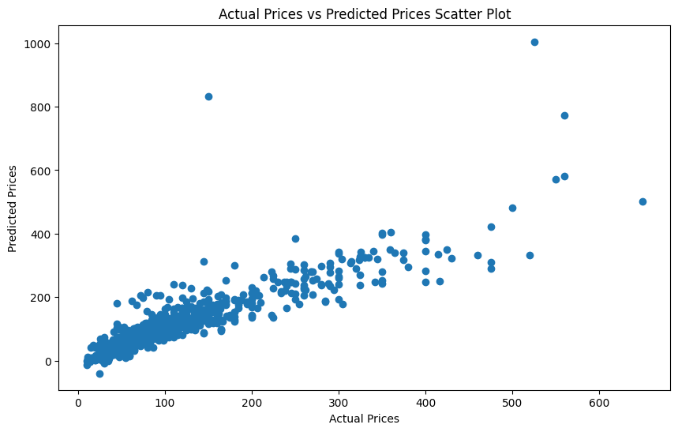
Result and Discussion
Model Evaluation:The R-squared score is calculated using r2_score() to evaluate the performance of all three models (i.e. Linear Regression , Lasso Regression & Artificial Neural Network’s MLP Regressor of scikit learn )on the test set.
Visualization:
Scatter Plot: A scatter plot is created to visualize the relationship between actual and predicted prices.
Linear Regression Lasso Regression Multilayer Perceptron Regressor

Slide 8

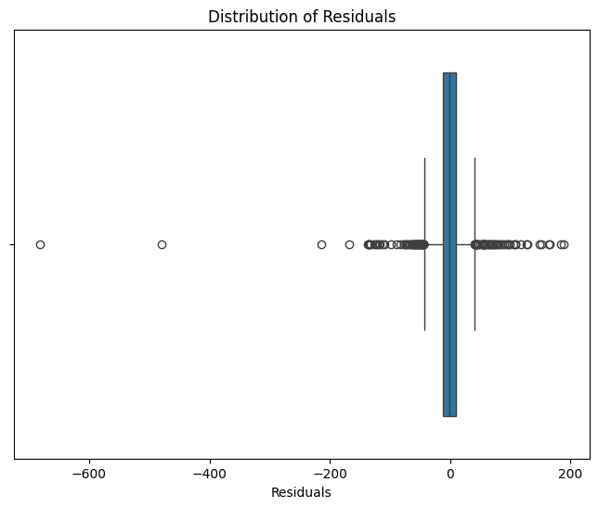
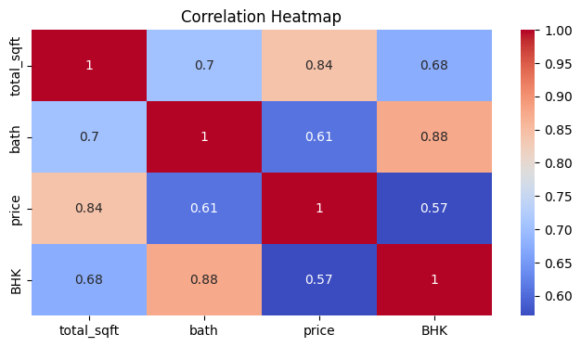
Result and Discussion(contd.)
Residual Analysis: A box plot is used to analyze the distribution of residuals (the difference between actual and predicted prices).
Correlation Heatmap:The correlation heatmap shows you the strength of the linear relationship between pairs of numerical features in your dataset. Positive values close to 1 indicate a strong positive correlation (as one feature increases, the other tends to increase as well).

Slide 9

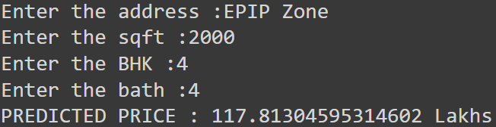
Result and Discussion(contd.)
Testing:
User Input: The code prompts the user to enter location, square footage, BHK, and number of bathrooms.
Prediction: The funcc() function is used to predict the price based on the user inputs.
Output: The predicted price is printed to the console.

Slide 10

Conclusion and Future Work
Model Performance:
Our ML model shows promising results in predicting house prices based on relevant features.
Fine-tuning and feature engineering can further enhance performance.
Feature Importance:
Essential features (e.g., square footage, location, neighborhood) significantly impact prices.
Understanding feature importance guides informed decisions during model development.
Deployment Plan(Future Work):
I’ll deploy the model via a Flask web app.
Users can input house features and receive estimated prices.

Slide 11
THANKYOU

